Slide 1
Communication in Distributed System
Remote procedure call(RPC)
Remote method invocation(RMI)
Message oriented Communication- MPI
Stream oriented communication

Slide 2
Remote Method Invocation
The RMI stands for Remote Method Invocation is an API mechanism.
Remote Method Invocation (RMI) allows an object to invoke a method on an object that exists in another address space, which could be on the same machine or on a remote machine.
This mechanism generally creates distributed applications in java.

Slide 3
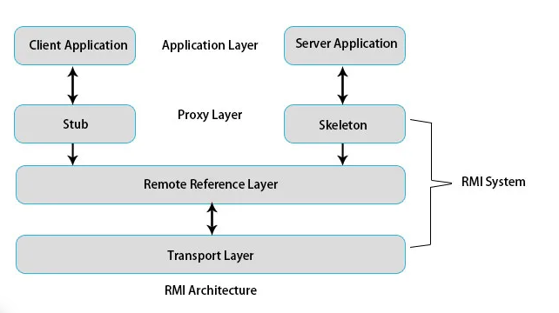
RMI architecture

Slide 4
The client application and server application are the respective JVMs of the client machine and server machine.
In the RMI application, we write two programs: the client program, which resides on the client, and the server program, which resides on the server machine.
The RMI provides remote communication between the applications using two objects stub and skeleton.

Slide 5
Stub
The stub is an object, acts as a gateway for the client side.
All the outgoing requests are routed through it.
It resides at the client side and represents the remote object. When the caller invokes method on the stub object, it does the following tasks:
It initiates a connection with remote Virtual Machine (JVM),
It writes and transmits (marshals) the parameters to the remote Virtual Machine (JVM),
It waits for the result
It reads (unmarshals) the return value or exception, and
It finally, returns the value to the caller.

Slide 6
Skeleton
The skeleton is an object, acts as a gateway for the server side object.
All the incoming requests are routed through it.
When the skeleton receives the incoming request, it does the following tasks:
It reads the parameter for the remote method
It invokes the method on the actual remote object, and
It writes and transmits (marshals) the result to the caller.

Slide 7
Remote reference layer
The proxy layer is connected to the RMI mechanism through the Remote Reference Layer.
This layer is responsible for the communication and transfer of objects between client and server.
The remote Reference Layer manages the references made by the client to the remote server object.
This layer is also responsible for handling duplicated objects.
Transport layer
The transport layer is responsible for setting up communication between the two machines.
The actual transportation of data is performed through this layer.

Slide 8
Persistent vs transient communication
Persistent communication
Message submitted for transmission is stored by communication system for as long as it takes to deliver it to receiver
Email,SMS
Not necessary for sender to continue excecution after submitting a message
Not necessary for receiver to be executing at the time message submission

Slide 9
Transient communication
In transient communication, messages is stored by communication system only for small periods of time as long as sending and receiving applications are executing
sender and receiver run at the same time based on request/response protocol, the message is expected otherwise it will be discarded
Receiver needs to be there when a message is received
Sender needs to be there when a message is send.

Slide 10
Synchronous vs. Asynchronous Communication
Synchronous communication
Sender is blocked until its message is stored in a local buffer at receiving host or actually delivered to receiver
Asynchronous communication
Sender continues immediately after message send.
Message may be stored in a local buffer at sending host or at an intermediate communication server

Slide 11
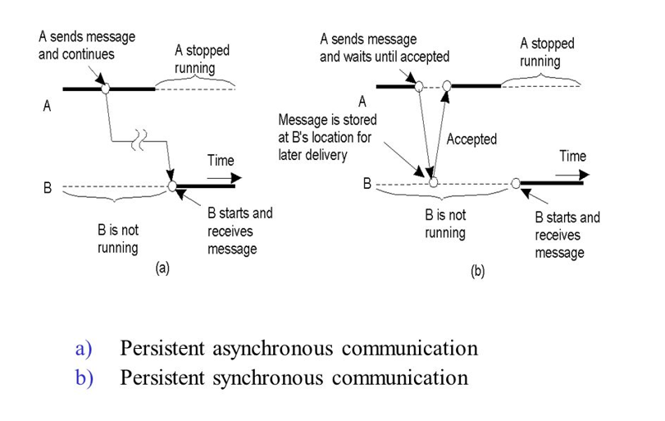

Slide 12
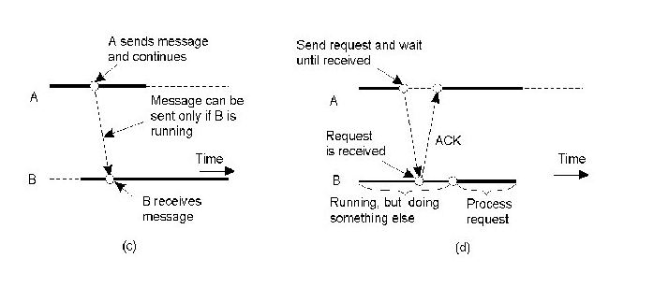
(c) Transient Asynchronous communication
(d) Transient synchronous communication

Slide 13
Message Passing Interface
MPI stands for Message Passing Interface.
MPI is used to send messages from one process (computer, workstation etc.) to another. These messages can contain data ranging from primitive types (integers, strings) to actual objects.
MPI is not a programming language.
MPI is a programming model that is widely used for parallel programming in a cluster. In the cluster, the head node is known as the master, and the other nodes are known as the workers.
By using MPI, programmers are able to divide up the task and distribute each task to each worker or to some specific workers. Thus, each node can work on its own task simultaneously.

Slide 14
Why MPI ?
There are many reasons for using MPI as our parallel programming model:
MPI is a standard message passing library, and it is supported on all high-performance computer platforms.
An MPI program is able to run on different platforms that support the MPI standard without changing your source codes.
Because of its parallel features, programmers are able to work on a much larger problem size with the faster computation.
There are many useful functions available in the MPI Library.
A variety of implementations are available.

Slide 15
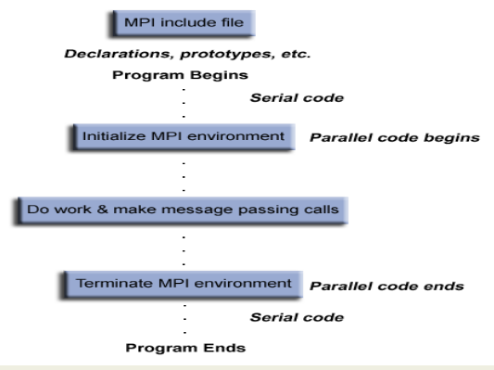
MPI Program Structure

Slide 16
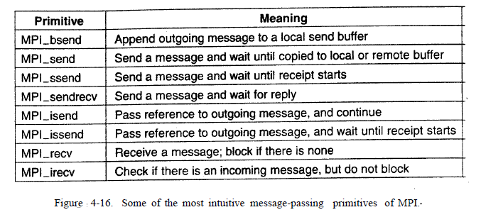
At the core of MPI are messaging primitives to support transient communication

Slide 17
MPI_bsend
The sender submits a message for transmission, which is generally first copied to a local buffer in the MPI runtime system.
When the message has been copied. the sender continues. The local MPI runtime system will remove the message from its local buffer and take care of transmission as soon as a receiver has called a receive primitive.

Slide 18
The primitive MPI_send may either block the caller until the specified message has been copied to the MPI runtime system at the sender's side, or until the receiver has initiated a receive operation.
Synchronous communication by which the sender blocks until its request is accepted for further processing is available through the MPI_ssend primitive.
Finally, the strongest form of synchronous communication is also supported: when a sender calls MPI_sendrecv, it sends a request to the receiver and blocks until the latterreturns a reply. Basically, this primitive corresponds to a normal RPC.

Slide 19
MPI_isend
A sender passes a pointer to the message after which the MPI runtime system takes
care of communication. The sender immediately continues. To prevent overwriting
the message before communication completes, MPI offers primitives to check
for completion, or even to block if required.

Slide 20
MPI_issend
a sender also passes only a pointer to the :MPI runtime system. When the runtime system indicates it has processed the message,the sender is then guaranteed that the receiver has accepted the message and is now working on it.
MPI_recv
It is called to receive a message; it blocks the caller until a message arrives.
There is also an asynchronous variant, called MPI_irecv
by which a receiver indicates that is prepared to accept a message.
The receiver can check whether or not a message has indeed arrived, or block until one does.

